Slide 1
Md Sharif Hossain
10th Semester
Dept of ECE (CSE)
North South University
ENG 111.7

Slide 2
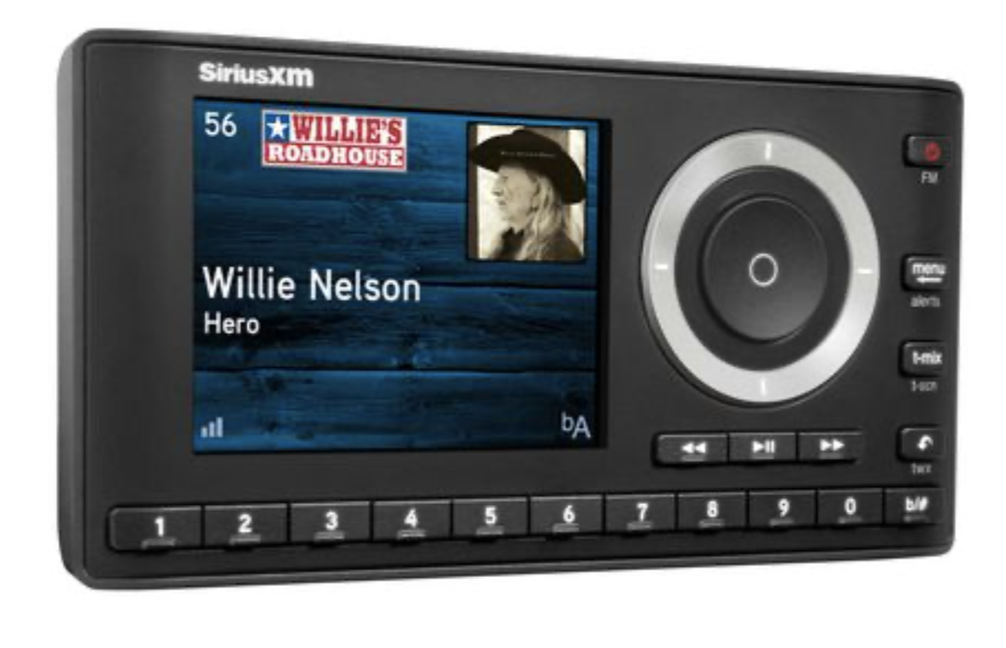
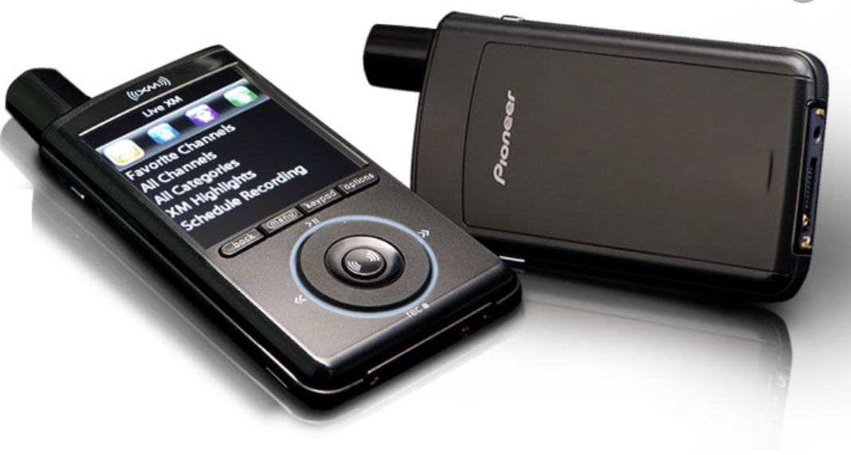
What is Satellite Radio?
According to Encyclopedia, “Satellite radio is a type of digital broadcast, which transmits audio signals over large areas with greater clarity and consistency than conventional radio.”
Fig: Car satellite radio and personal satellite radio

Slide 3
General operating Range of a satellite radio
Satellite radio is a paid radio service that can broadcast its signal from more than 35,000 KM away with complete clarity. That means you could drive from Dhaka to France without ever having to change the radio station!

Slide 4
History of Satellite radio
The first satellite radio broadcasts occurred in Africa and the Middle East in 1999.

Slide 5
Kinds of radios
There are three famous types of radios. Those are:
AM/FM radio
Digital television radio (DTR)
Satellite Radio

Slide 6
Difference between Satellite radio and FM radio
Radio Format | Satellite | AM/FM
Monthly Fees | Around US$10.99 and up | Free
Portability | Available | Prominent
Listening availability | Very high—a satellite signal's footprint covers millions of square kilometers. | Very low when compared to satellite radio. Around 30-40 miles from the station

Slide 7
Secondly, I will talk about who gives the service and how the process is done around the world

Slide 8
Satellite radio service providers around the world
At this time, there are two space-based radio broadcasters:
Sirius XM Radio
1worldspace.

Slide 9
Company strategies
As of March 2013, SiriusXM had 24.4 million subscribers. This was primarily due to the company’s partnerships with automakers and car dealers.
Roughly 60% of new cars sold come equipped with SiriusXM, and just under half of those units gain paid subscriptions.
The company has long-term deals with General Motors, Ford, Toyota, Kia, Bentley, BMW, Volkswagen, Nissan, Hyundai and Mitsubishi.

Slide 10
Space Logistics of the providers
As of May 2017, there are five satellites in orbit; two XM and two Sirius satellites and one spare all owned by Sirius XM.
1worldspace operated two satellites: AfriStar and AsiaStar.

Slide 11
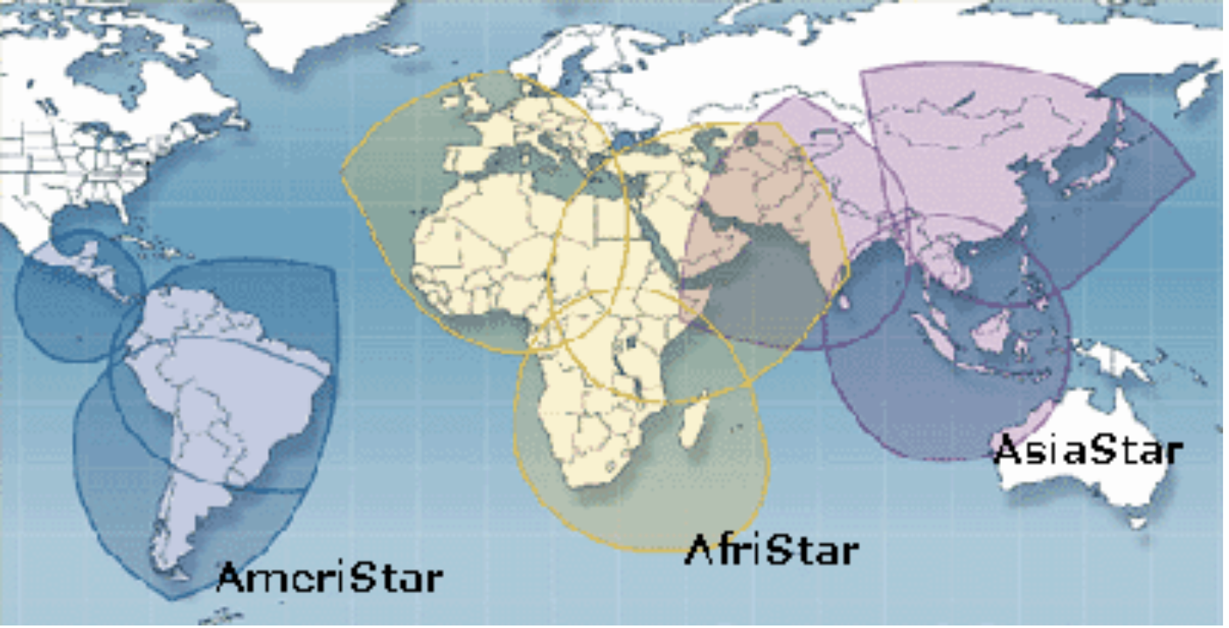
Space Logistics of the providers
Fig: Area covered by satellites of 1WorldSpace

Slide 12
Space Logistics of the providers
The interesting thing is, those 8 satellites took an average cost of 150 million USD which is far lower than the Bangabandhu satellite project which ended up with a cost of 250 Million USD.

Slide 13
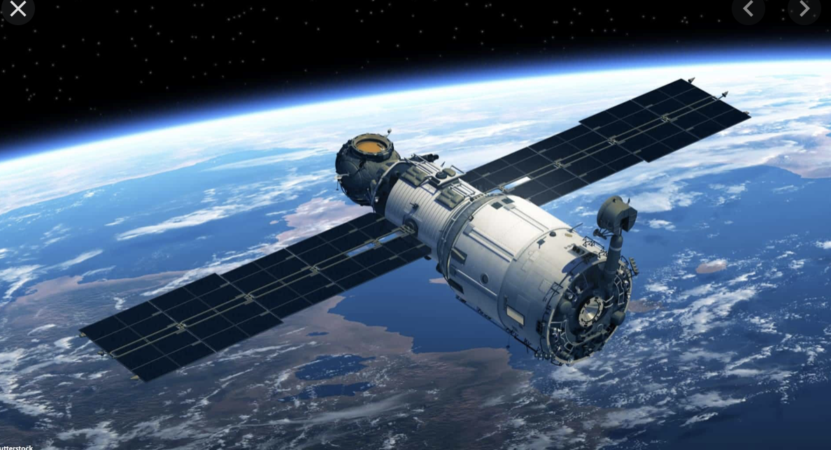
Key components of satellite radio systems
1. Satellites:

Slide 14
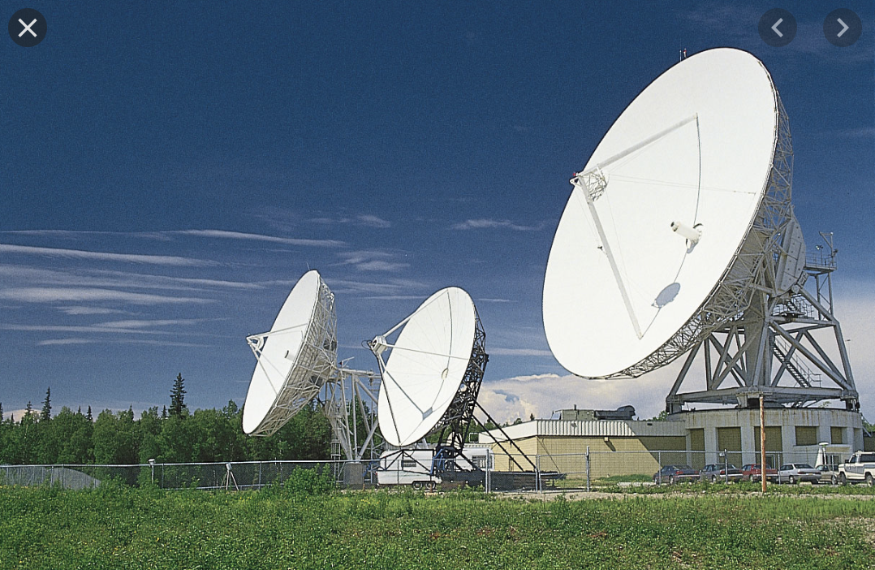
Key components of satellite radio systems
2. Ground repeaters:

Slide 15
Key components of satellite radio systems
3. Radio receivers:

Slide 16
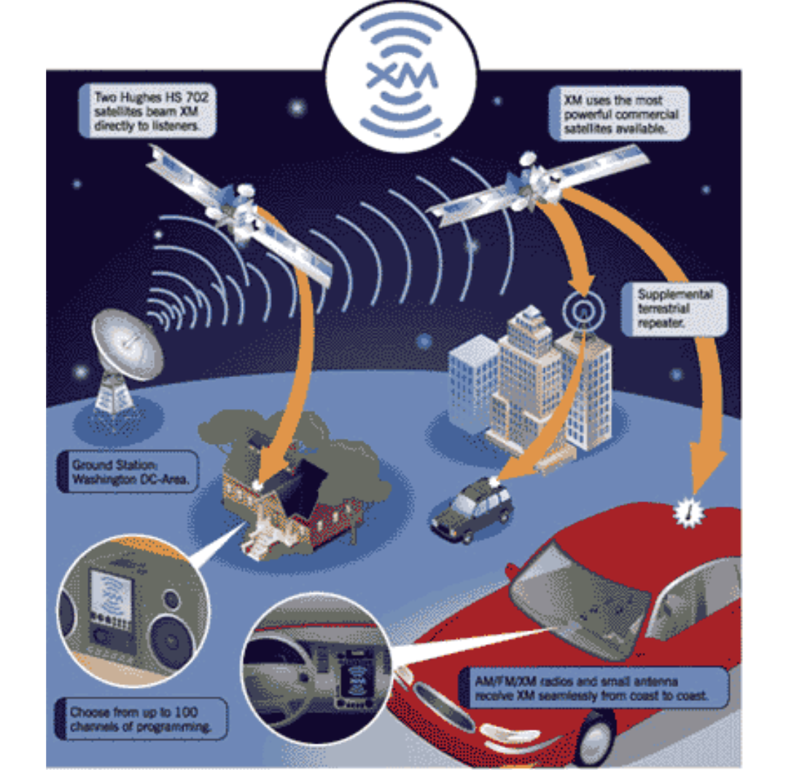
Process of how Satellite radio works

Slide 17
Finally, I will discuss the procedure to establish a satellite radio channel in our country

Slide 18
Radio channel controller in Bangladesh
Bangladesh Telecommunication Regulatory Commission (BTRC) controls the licensing of all Satellite radio channels in Bangladesh.

Slide 19
Pre requirement
According to Authority, frequency is assigned from BTRC to the licensee from 87.5 to 108 MHz.

Slide 20
Process of licensing
The license of FM radio/Community radio broadcasting is given from the Ministry of Information to establish and operate radio stations under private ownership.
After awarding license, licensee(s) shall have to apply for assigning frequency and to import Earth Station and SNG/DSNG equipment to BTRC.
After assigning a frequency to the licensee, the licensee will eligible to import radio equipment by getting prior permission from BTRC.
The application format and list of necessary documents could be found in the website of BTRC.

Slide 21
Future of Satellite radio in Bangladesh
The major customers of satellite radios are car and ship companies, long-distance travelers and military persons. Bangladesh is currently a developing country. But there are no car manufacturing companies yet. Also, it's a very small country. So, FM radio plays a sufficient role in radio communication in this country. As a result, there is hardly a potential market for satellite radio in Bangladesh.

Slide 22
Conclusion
To conclude, I would like to repeat that Satellite Radio is a multibillion technological service of the 21st century which is famous for transmitting audio signals over large areas with greater clarity and consistency than conventional radio or FM radio.

Slide 23
Conclusion
The funny thing is that, at its core, radio is an incredibly simple technology. With just a couple of electronic components that cost at most a d­ollar or two, you can build simple radio transmitters and receivers. The story of how something so simple has become a bedrock technology of the modern world is fascinating!

Slide 24
Conclusion
Unfortunately, This multibillion technology is still operating below the profit line. 1WorldSpace went Bankrupt in 2009 and Sirius and XM merged in 2008 to form Sirius XM to avoid bankruptcy.
Can this genius technology make a good profit in future? Only time can answer this!

Slide 25
Thank You everyone!
?

